Slide 1
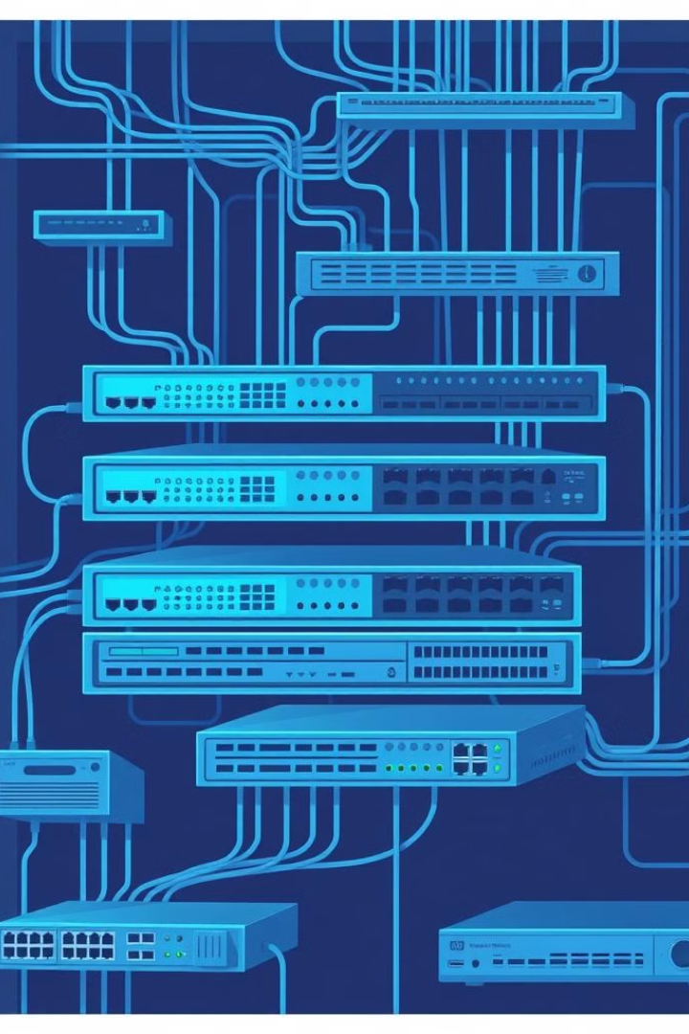
Infrastructure Network Design in Cisco Packet Tracer
This section will guide you through the design and configuration of an infrastructure network using Cisco Packet Tracer. We'll cover the network components, topology, and step-by-step setup of routers, switches, and end devices.

Slide 2
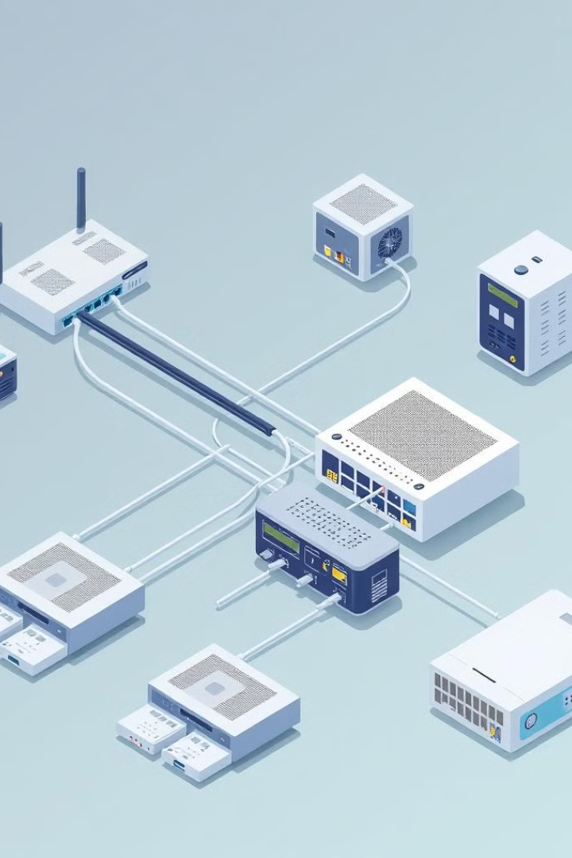
Overview of Network Components
1
Routers
2
Switches
2911 Routers provide core routing functionality and interconnectivity between network segments.
2960-24TT switches enable local area network (LAN) connectivity for end devices.
3
Multilayer Switches
3560-24PS multilayer switches offer advanced features like VLANs and routing capabilities.

Slide 3

Topology Diagram and Layout
The network topology consists of 5 routers, 4 switches, and 3 multilayer switches, with end devices connected to each switch and multilayer switch.

Slide 4
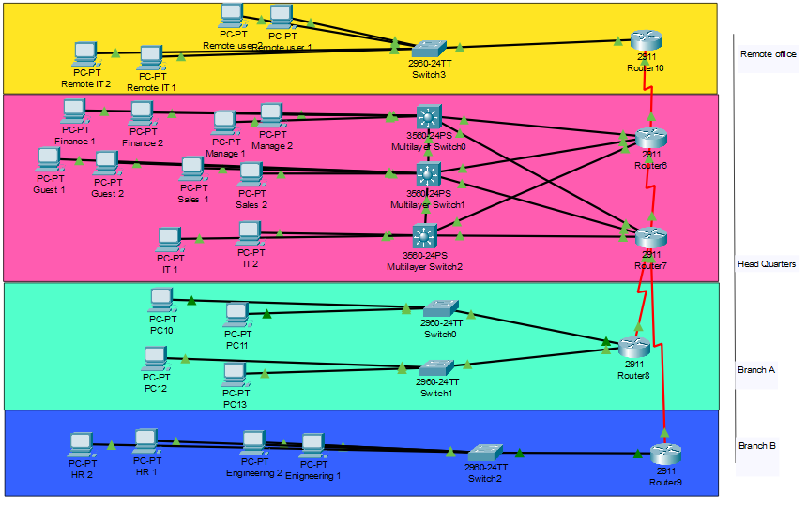

Topology Diagram and Layout
The provided screenshot shows the visual layout of the network topology within the Cisco Packet Tracer software, allowing for detailed configuration and testing.

Slide 5
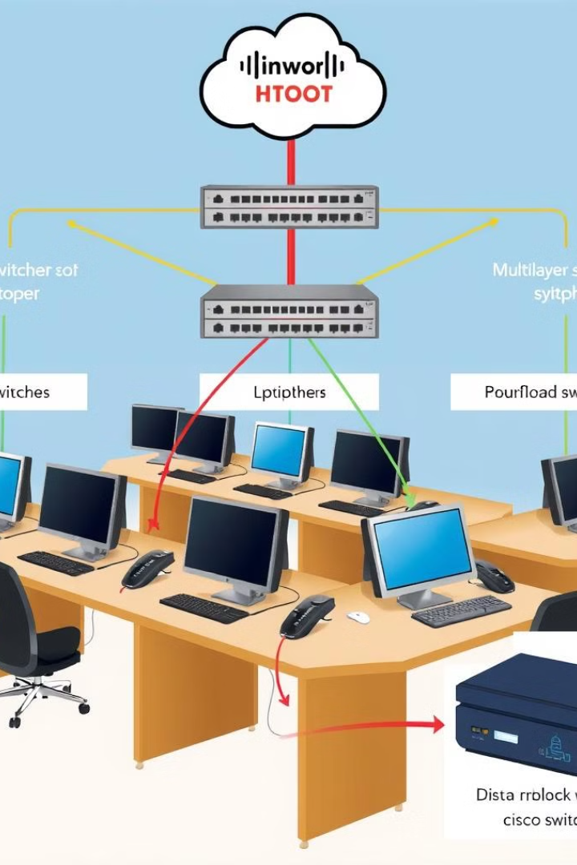



Connecting End Devices to Switches and Multilayer Switches
Device Discovery
Configuring the network to automatically discover and register end devices.
VLAN Assignments
Assigning end devices to the appropriate VLANs for logical segmentation.
Port Security
Implementing port security measures to protect the network from unauthorized access.

Slide 6
Introduction to IP Addressing :
In this project, I was responsible for assigning static IP addresses to devices across multiple sites.
The goal was to ensure stable connections between different subnets at each site.
Static IPs also help in managing the network and improving security.

Slide 7

Why Static IP Addressing was Used :
Reasons for choosing Static IP Addressing in this project:
• Provides a stable and consistent network environment for critical devices.
• Simplifies network management and helps in identifying devices easily.
• Ensures proper communication between VLANs, routers, and key network devices.
• Facilitates better control over security settings, especially for sensitive departments like IT and Finance.

Slide 8
IP Addressing Plan for Each Site :
Headquarters (HQ):
• VLAN 10 (Management): 172.16.10.0/24
• VLAN 20 (Sales): 172.16.20.0/24
• VLAN 30 (IT): 172.16.30.0/24
• VLAN 40 (Finance): 172.16.40.0/24
• VLAN 50 (Guest): 172.16.50.0/24
Branch A: 192.168.100.0/24, 192.168.110.0/24
Branch B: VLAN 120: 192.168.120.0/24, VLAN 130: 192.168.130.0/24
Remote Office: VLAN 140: 192.168.140.0/24,
VLAN 150: 192.168.150.0/24

Slide 9
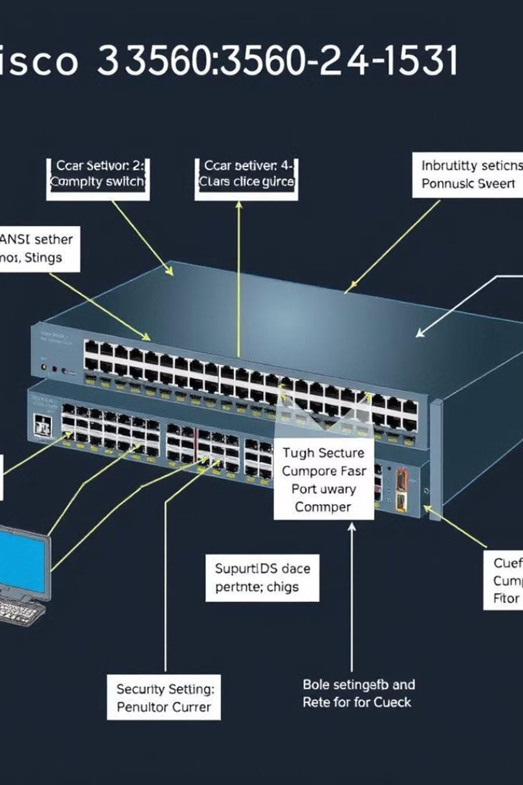
-Vlans and port security
-assigning vlans:
Assigned VLANs across multiple sites to ensure network segmentation and efficiency:
HQ:
VLAN 10 – Management
VLAN 20 – Sales
VLAN 30 – IT
VLAN 40 – Finance
VLAN 50 – Guest Network
Branch B:
VLAN 120 (Engineering) and VLAN 130 (HR)
Remote Office:
VLAN 140 (Remote Users) and VLAN 150 (Remote IT)
Usage and Advantages of VLANs:
Network Segmentation:
Reduces broadcast traffic by grouping devices logically, not physically.
Ensures each department operates independently, improving performance.
Security Enhancements:
Limits access to sensitive data (e.g., Finance VLAN).
Unauthorized devices on one VLAN cannot access other VLANs without proper routing rules.
Improved Management:
Centralized control of devices and users based on function (e.g., Guest network).
Simplifies troubleshooting by isolating traffic per VLAN.
Efficient Resource Allocation:
Traffic can be prioritized (e.g., Management VLAN gets higher priority).
Inter-VLAN routing allows seamless communication where needed while restricting unnecessary access.

Slide 10
Usage and Advantages of VLANs:
Network Segmentation:
Reduces broadcast traffic by grouping devices logically, not physically.
Ensures each department operates independently, improving performance.
Security Enhancements:
Limits access to sensitive data (e.g., Finance VLAN).
Unauthorized devices on one VLAN cannot access other VLANs without proper routing rules.
Improved Management:
Centralized control of devices and users based on function (e.g., Guest network).
Simplifies troubleshooting by isolating traffic per VLAN.
Efficient Resource Allocation:
Traffic can be prioritized (e.g., Management VLAN gets higher priority).
Inter-VLAN routing allows seamless communication where needed while restricting unnecessary access.

Slide 11

Port security:
Port Security uses :
Prevent unauthorized devices from gaining access.
Protect against MAC address flooding and network disruptions.
Implementation:
Set sticky MAC addresses for some devices.
Configured port shutdown mode for unauthorized access attempts.
Advantages of Port Security:
Improves network stability by limiting the number of devices on ports.
Prevents rogue devices from accessing the network.
Protects against malicious attacks, such as MAC spoofing.

Slide 12
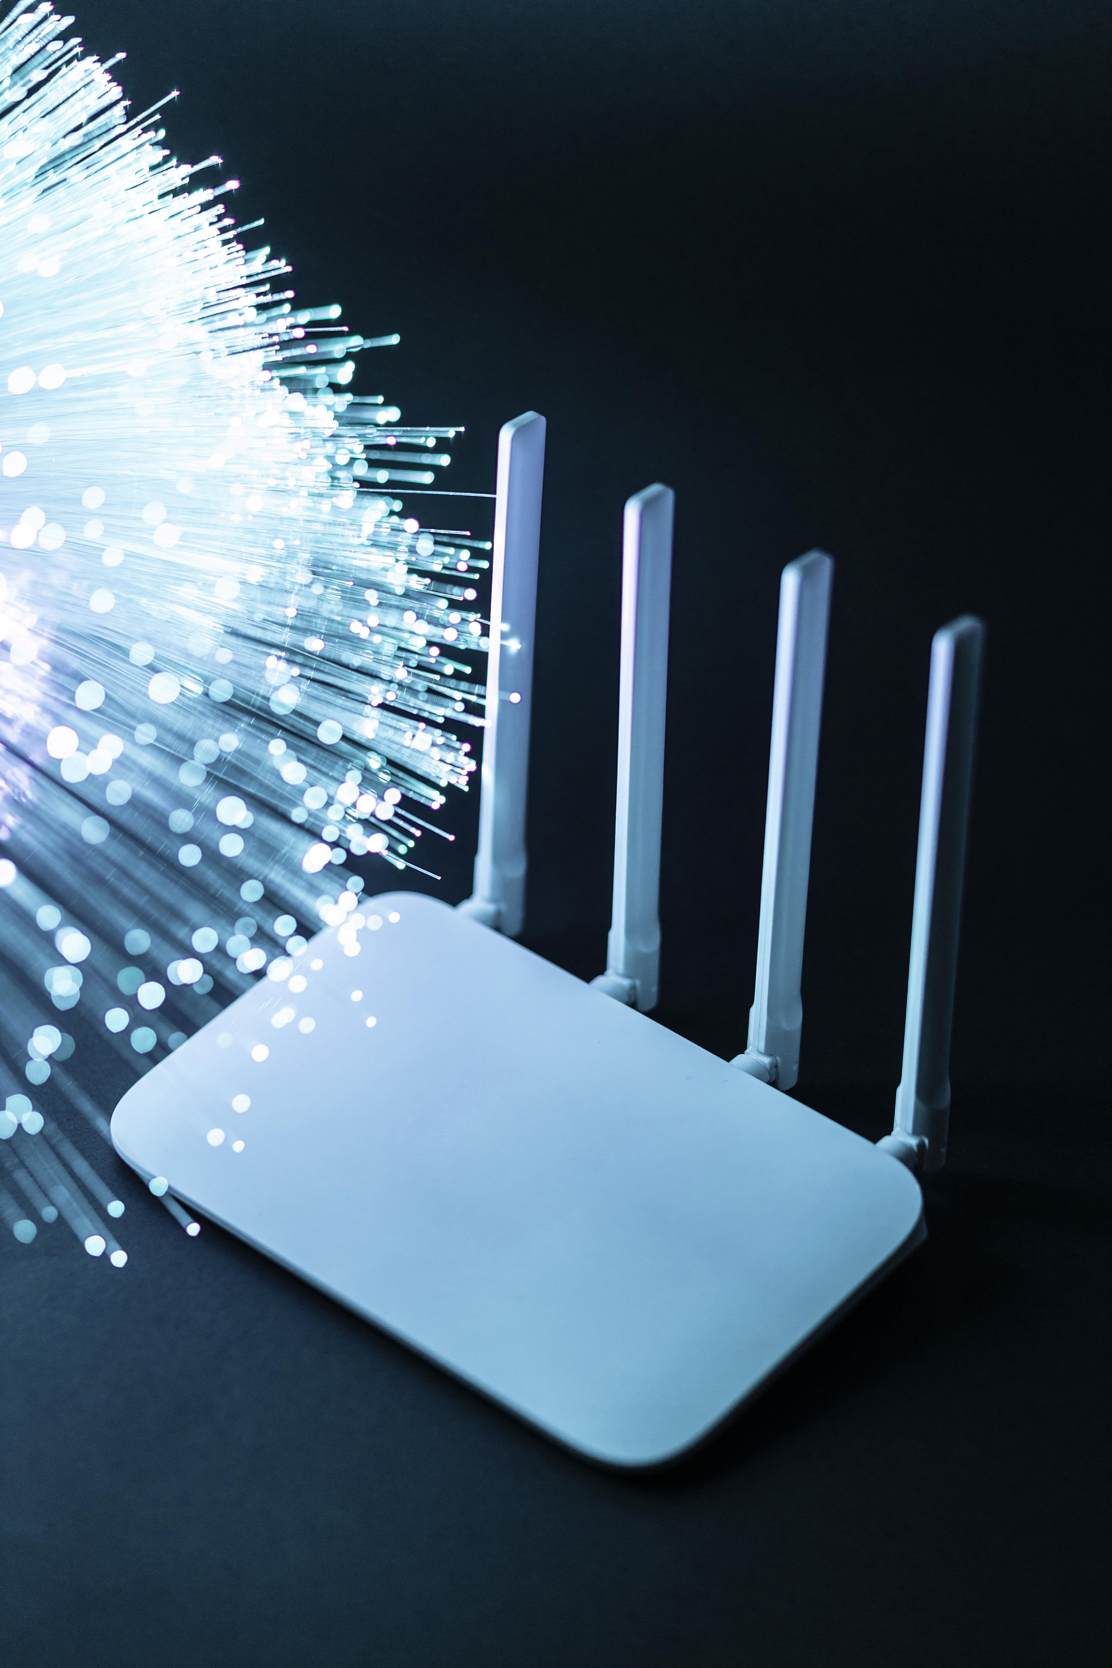
-Inter-VLAN Routing Configuration
-At HQ, inter-VLAN routing is done using Layer 3 switches.
interface Vlan10
ip address 172.16.10.1 255.255.255.0
interface Vlan20
ip address 172.16.20.1 255.255.255.0
-At Branch B, inter-VLAN routing is configured using Router-on-a-Stick.
interface GigabitEthernet0/0.120
encapsulation dot1Q 120
ip address 192.168.120.1 255.255.255.0

Slide 13
-OSPF Configuration Overview
-OSPF configuration steps:
OSPF Area Assignments: HQ in Area 0, Branch A/B in Area 1, Remote Office in Area 2.
Route Summarization at ABRs for efficient routing.
Passive Interfaces to block unnecessary OSPF updates on access networks.
Adjusting Reference Bandwidth for high-speed links.
-OSPF configuration Example:
router ospf 1
network 172.16.0.0 0.0.255.255 area 0
passive-interface default
no passive-interface GigabitEthernet0/1
auto-cost reference-bandwidth 10000
Verify using: show ip ospf neighbor

Slide 14
-Troubleshooting and Testing
-Common issues and troubleshooting steps:
OSPF Neighbor Issues: Check using 'show ip ospf neighbor’.
Misconfigured Areas: Ensure correct area assignments.
Route Summarization: Verify with 'show ip route’.
Inter-VLAN Routing: Ensure correct subinterfaces and VLAN tagging.
-Verification Steps:
OSPF: Use 'show ip ospf neighbor' and 'show ip route' to verify OSPF configurations.
Inter-VLAN Routing: Test connectivity between VLANs using 'ping'.

